Slide 1
Sustainability of Marine Aquaculture
Case Study: Salmon Farming

Slide 2
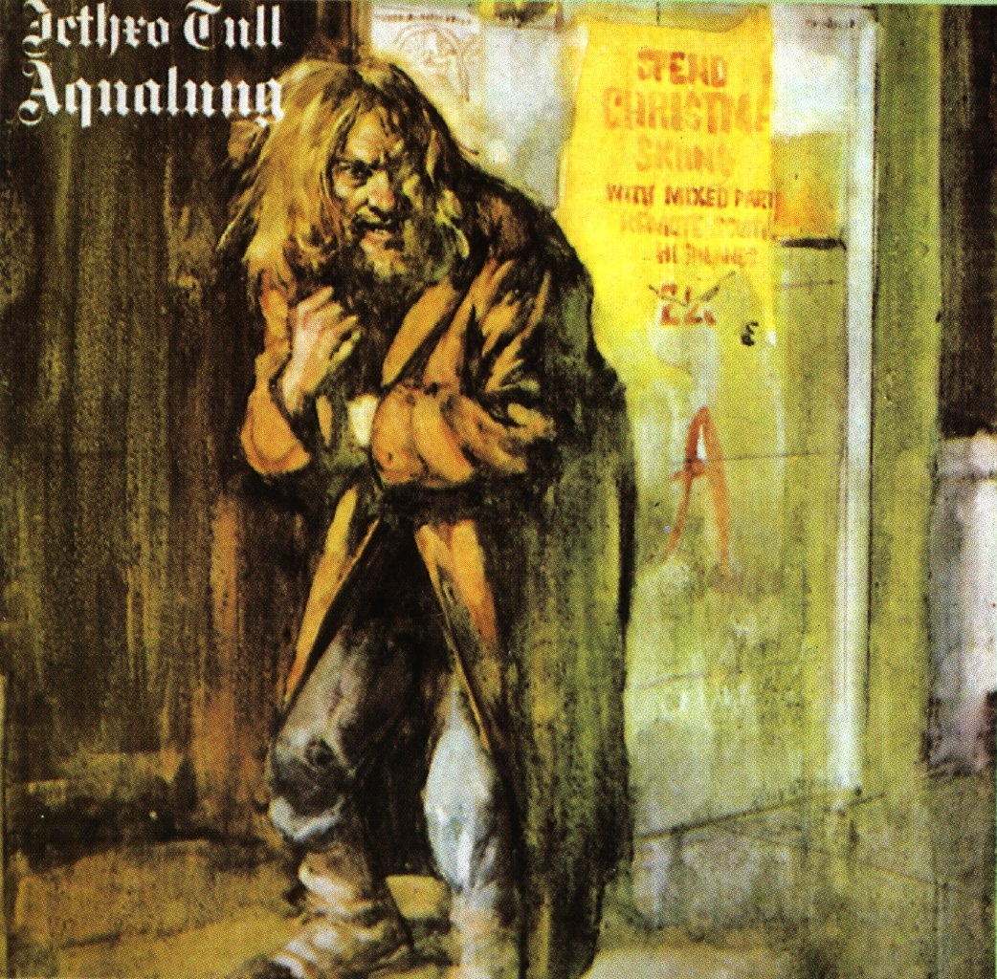

“From Aqualung to a watery investment”

Slide 3
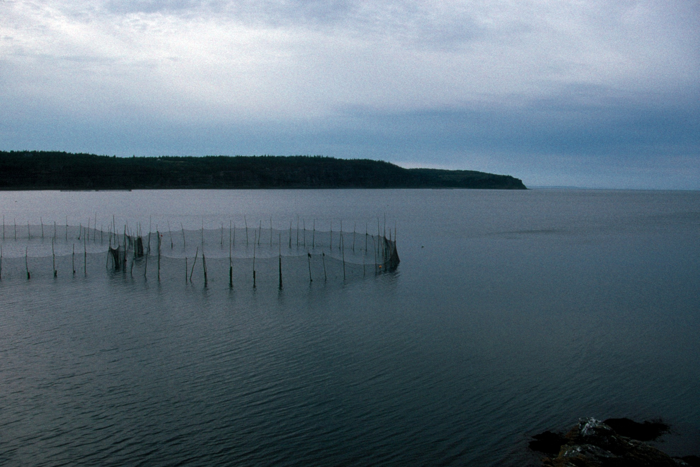

Slide 4
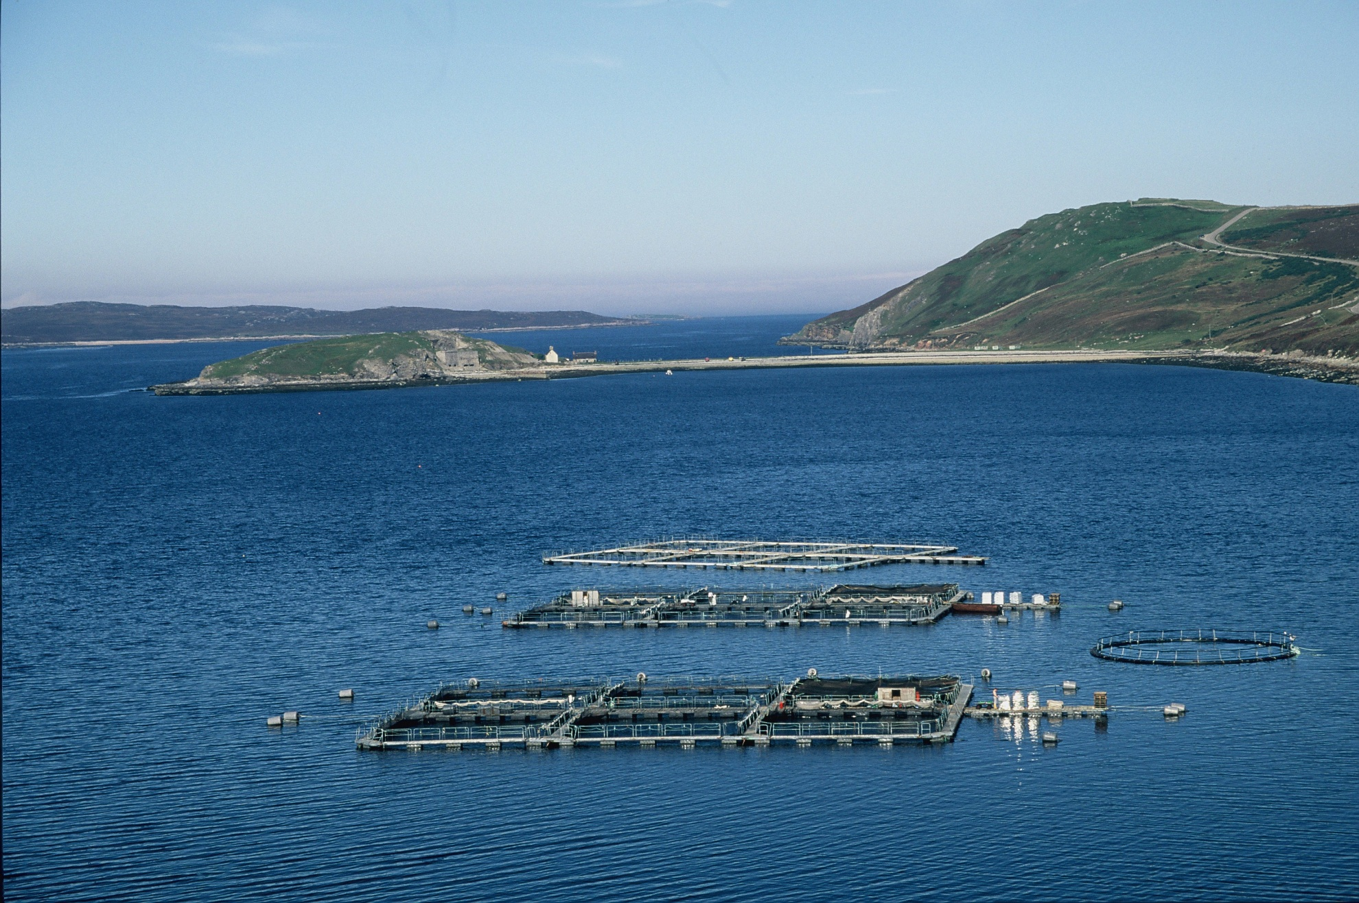

Slide 5
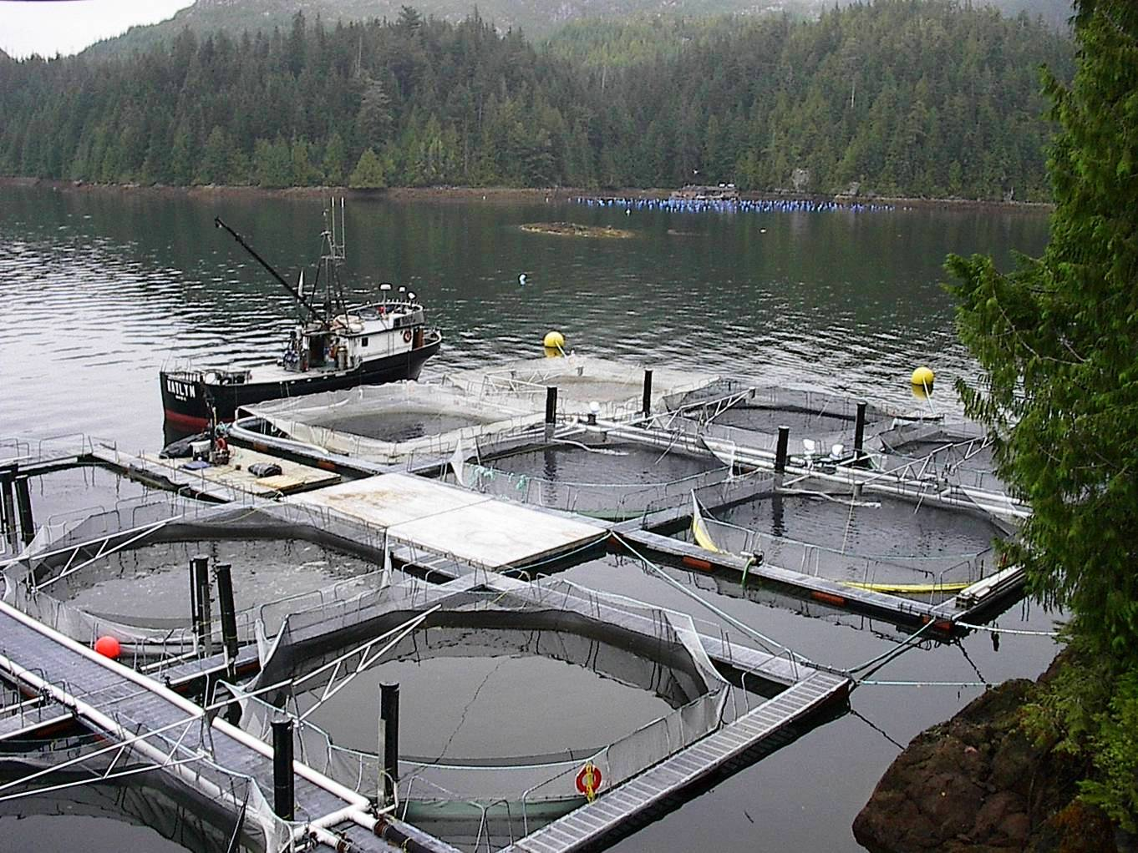

Slide 6
Tens of thousands of juvenile farmed Atlantic salmon have escaped from an acquaculture pen operation near Grand Manan Island, New Brunswick, located at the mouth of the Bay of Fundy.
That's according to the Atlantic Salmon Federation, which says 138,000 fish escaped …
ASF officials say the salmon are capable of surviving in the ocean. They say that raises concerns that the cultivated fish will interbreed with wild salmon, weakening the wild species. …
– Maine Public Broadcasting Network, Jan. 7, 2011

Slide 7
Farming salmon
Three-year process
In first year: Eggs fertilized and fry grow to approximately 100 g. in controlled freshwater setting
Fish then transported to saltwater cages and raised to harvest size of 4-5 kg. Grow-out may last one or two years.
After harvest, fish are transported to processing plants for slaughtering and gutting.
Processed fish may be frozen or smoked.

Slide 8
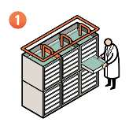
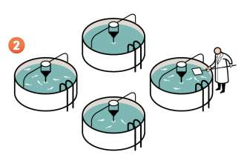
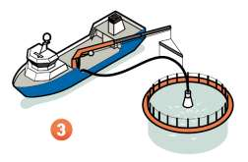
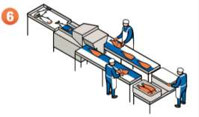
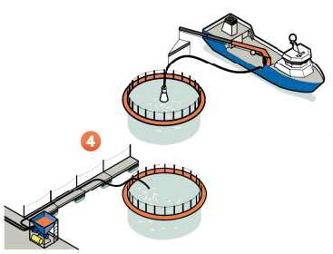
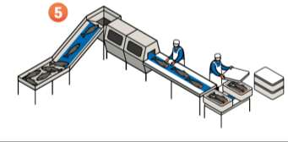

Slide 9
Salmon harvest trivia
From Marine Harvest 2012 investors’ handbook:
Salmon harvest (both wild-caught and farmed) has increased 600 percent since 1980
Farmed salmon harvest averaged about 50 percent greater than wild-caught harvest in past decade
In 2011, harvest of farmed Atlantic salmon was 1.5 million tonnes HOG
Farmed salmon have a feed conversion ratio of 1.2

Slide 10
Feed conversion ratio
More than 60 percent of the flesh of Atlantic salmon is edible meat.
Species | Feed Conversion Ratio
Cattle | 8.0
Pork | 3.0
Poultry | 2.0
Farmed salmon | 1.2
Wild salmon | 10.0

Slide 11
Energy inputs – Atlantic salmon
Marine Harvest says that electricity makes up about 10 percent of the cost of raising Atlantic salmon in the freshwater and production phases.
Inputs per tonne harvested | Freshwater phase | Saltwater phase | Transport | Total
Labor (person-days) | 0.67 | 3.3 | 0.51 | 4.5
Dry feed (kg) | 34 | 1,736 |  | 1,770
Gasoline (MJ) | 69 | 1,171 |  | 1,240
Diesel (MJ) | 176 | 1,037 | 3119 | 4,332
Propane (MJ) | 251 | 239 |  | 490
Electricity (MJ) | 679 | 0 |  | 679

Slide 12
Energy inputs – Atlantic salmon
Inputs per tonne harvested (includes cost of providing feed) | Total Energy Inputs | GHG emissions (kg CO₂)
Labor (person-days) | 4.6
Gasoline (MJ) | 1,240 | 115
Diesel (MJ) | 56,331 | 4,951
Natural Gas (MJ) | 20,702 | 1,199
Propane (MJ) | 490 | 28
Electricity (MJ) | 5,014 | 134
Total (MJ) | 93,089 | 6,427
Ecosystem support, freshwater phase (ha) | 1.04
Ecosystem support, saltwater phase (ha) | 9.9

Slide 13
Energy inputs – feed production
Data from Tydmers (2000), “Salmon and sustainability : the biophysical cost of producing salmon through the commercial salmon fishery and the intensive salmon culture industry”
Most of the energy input (98 percent) is devoted to supplying dry feed during grow-out operations.
Tydmers concluded that commercial fishing was more sustainable—in terms of energy inputs—than salmon farming.

Slide 14
Fish feed
According to Marine Harvest data, feed makes up largest share of production cost
Feed made from fish oil, fish meal, vegetable oil, vegetable meal, and avian meal.
Use of wild fish in feed has declined over the past decade or two.
Marine Harvest suggests use of trimmings and discards from processing of food fish to make fish meal
Marine Harvest also suggests bycatch, currently discarded, could supply a substantial portion of fish oil production.

Slide 15
Other resource consumption
1 kg of Atlantic salmon requires 1,500 liters of freshwater
Vaccines for disease prevention and antibiotics for treatment (these are not quantified in Marine Harvest handbook)

