Slide 1
Last Call for Corals
Images  Mar. 8, 2011

Slide 2

A Sand County Almanac

Slide 3
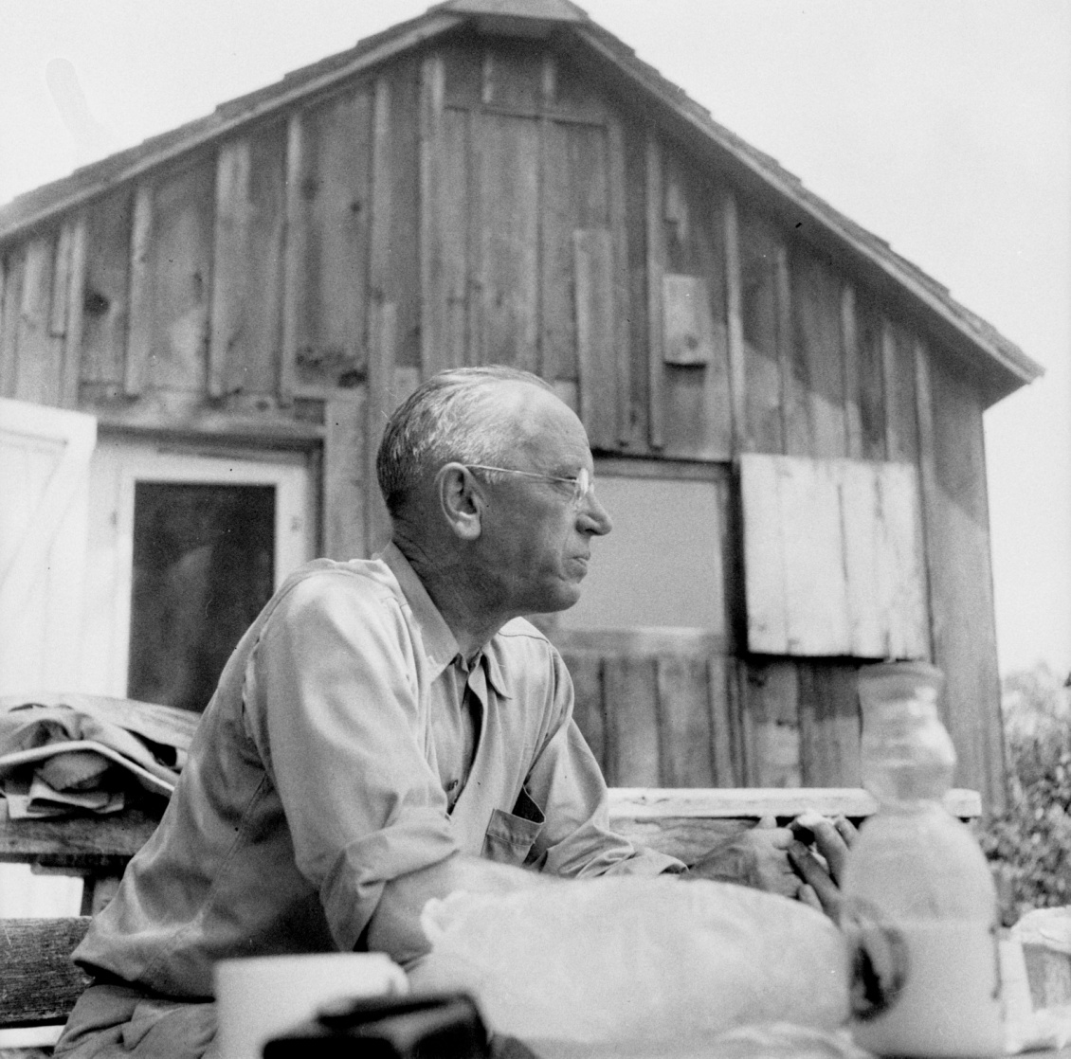
Aldo Leopold

Slide 4
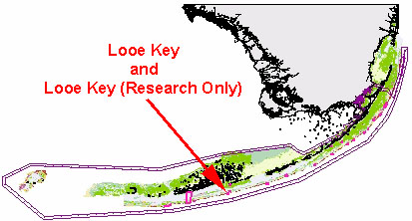
Florida Keys NMS

Slide 5
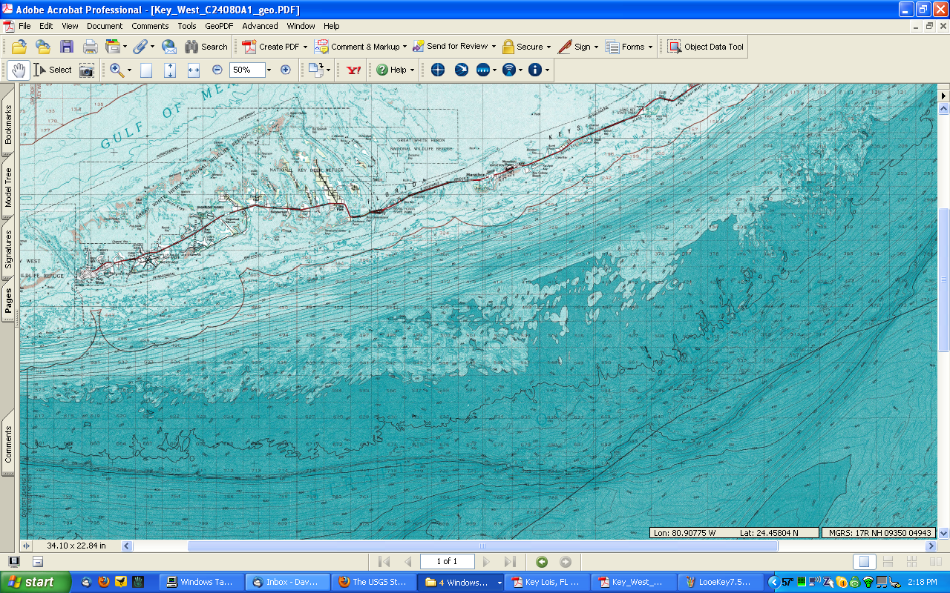
Florida Keys

Slide 6
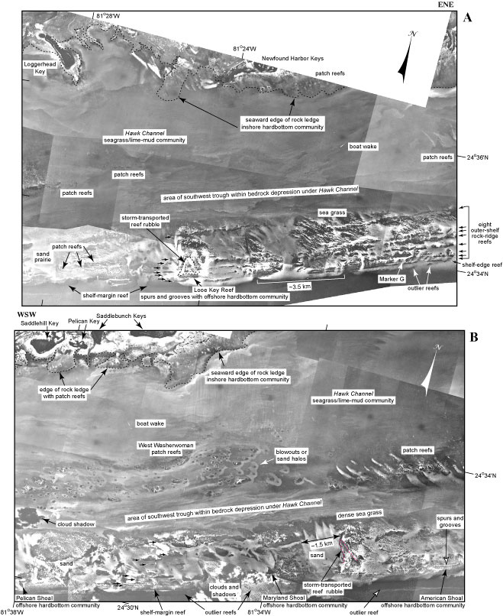
Florida Keys aerial views

Slide 7
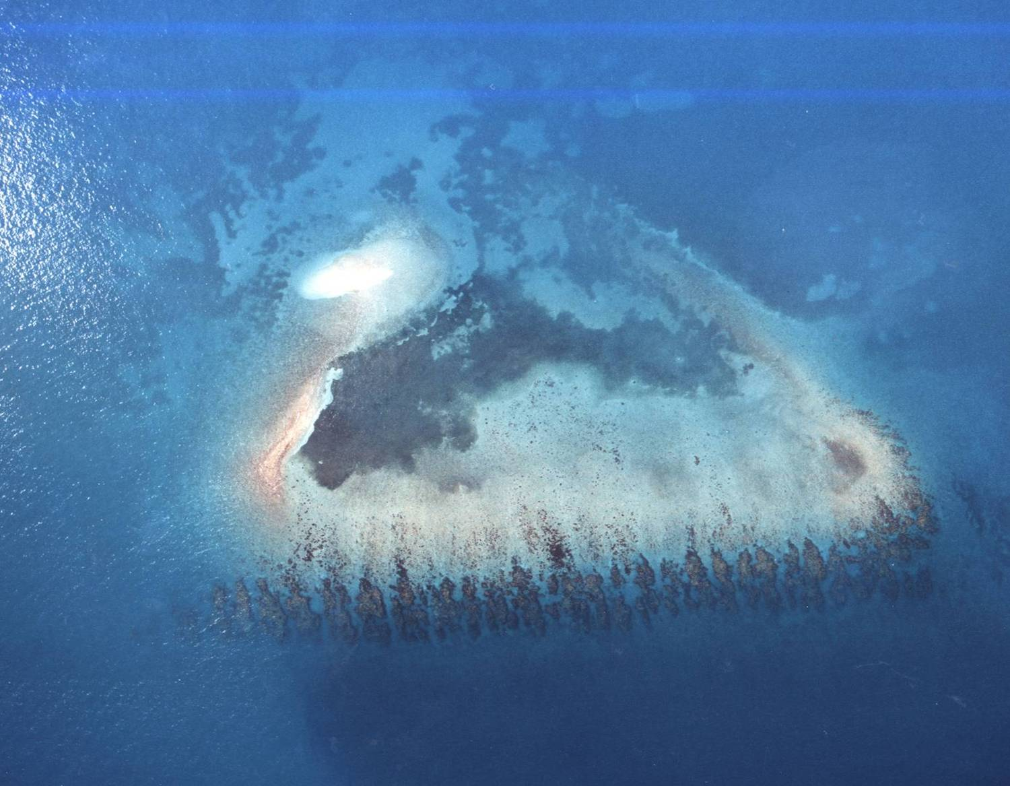
Looe Key Reef aerial view

Slide 8
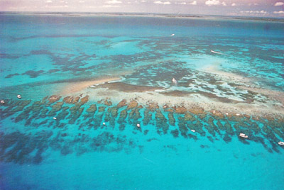
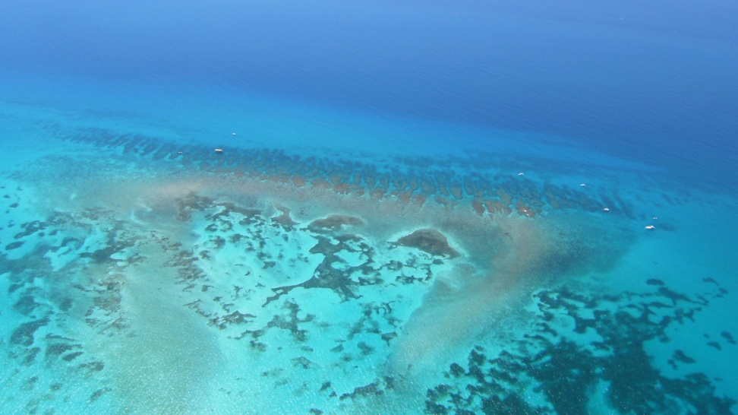
Looe Key Reef aerial views

Slide 9
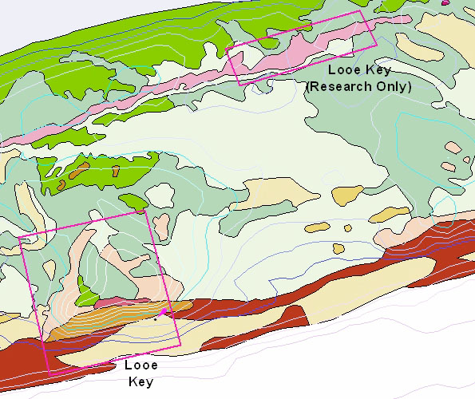
Looe Key NMS

Slide 10
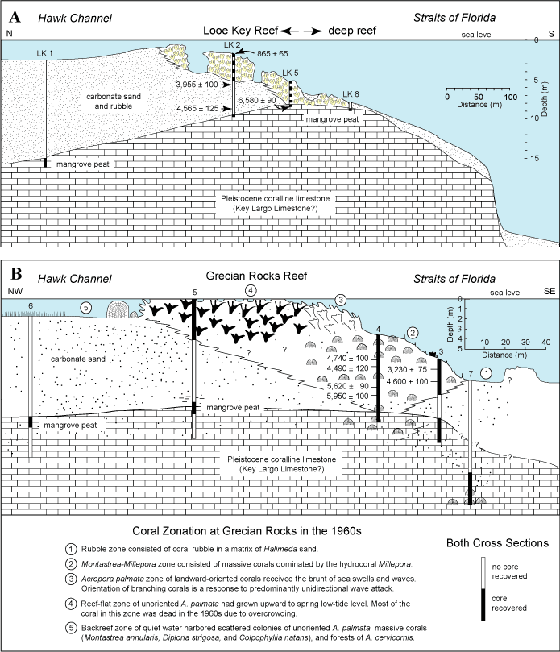
Looe Key geology

Slide 11
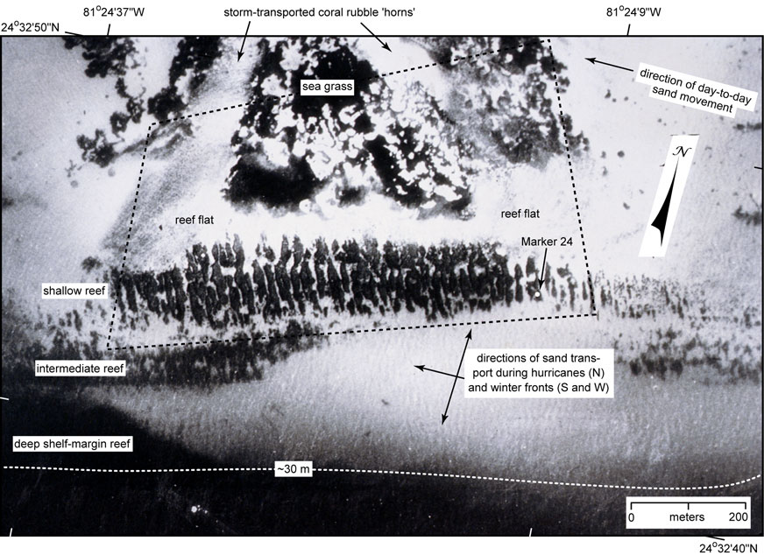
Looe Key features

Slide 12
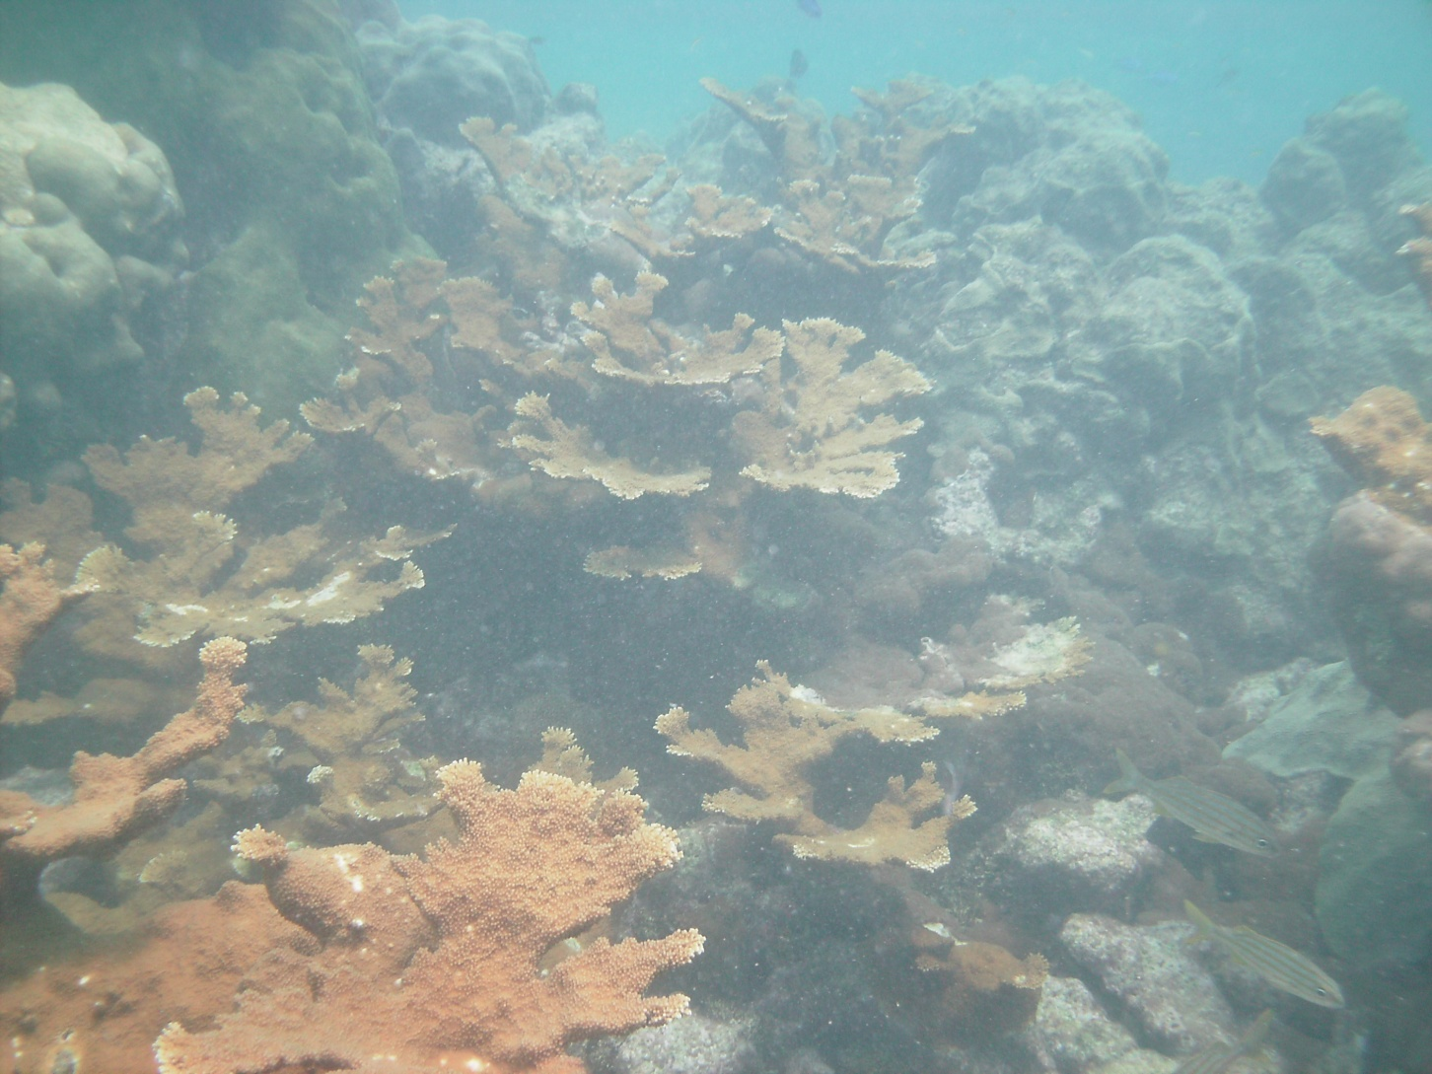
Elkhorn coral

Slide 13
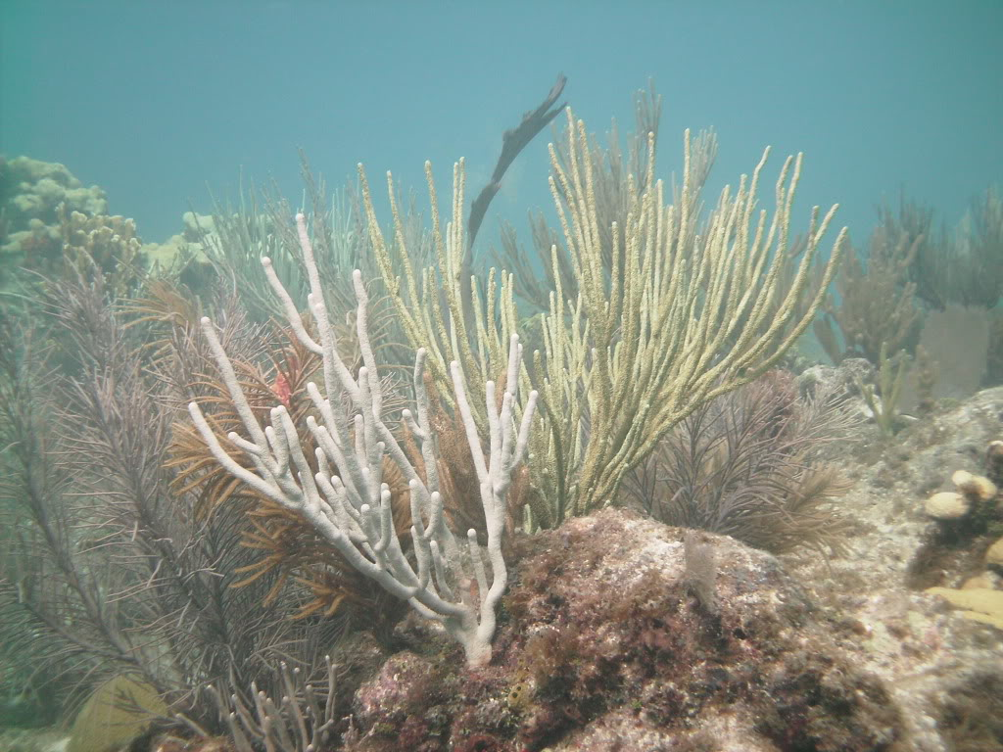
Staghorn corals and gorgonians

Slide 14
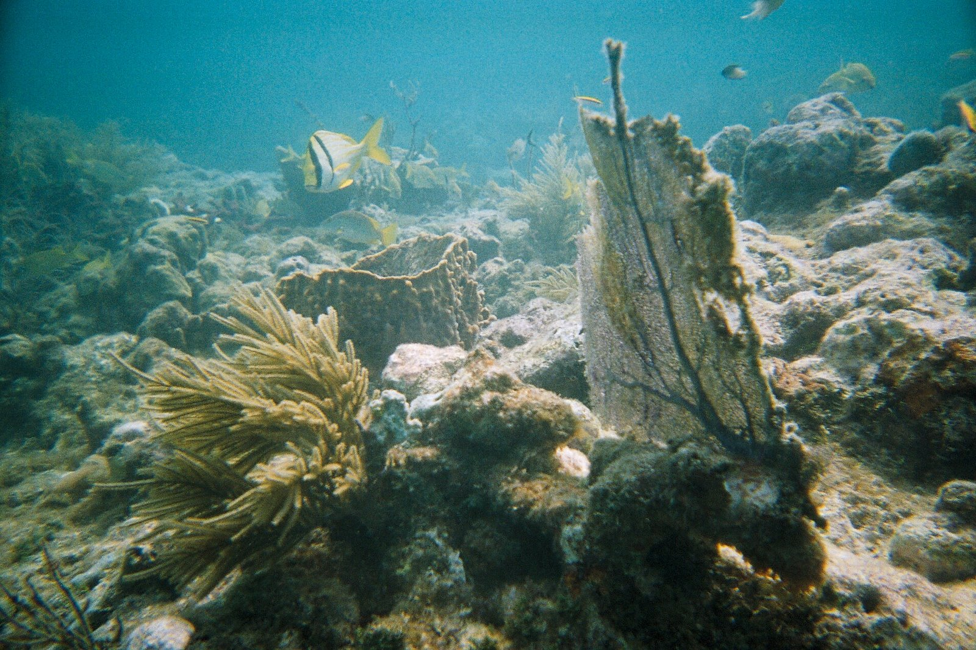
Gorgonians and debris

Slide 15
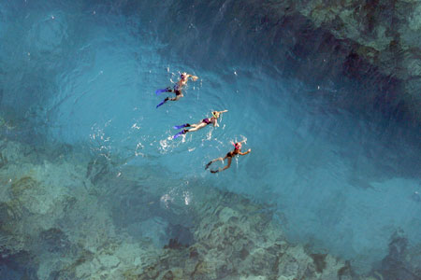
Spurs and grooves

Slide 16
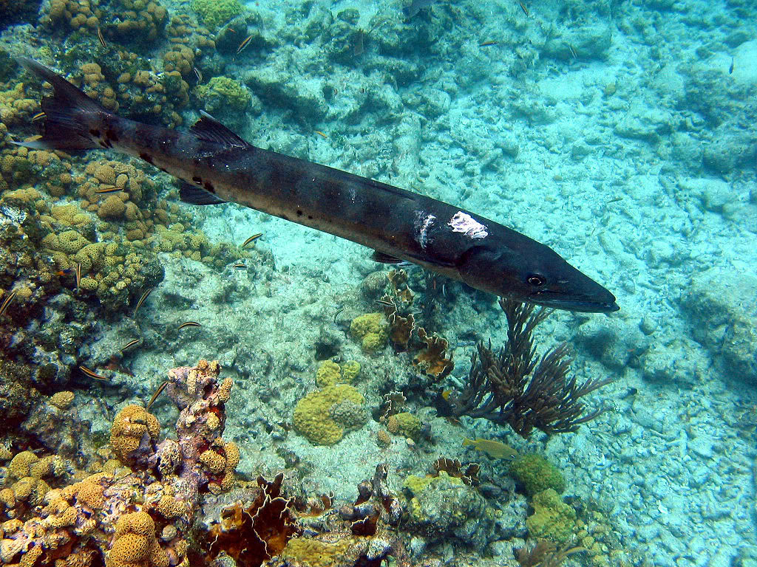
Barracuda

Slide 17
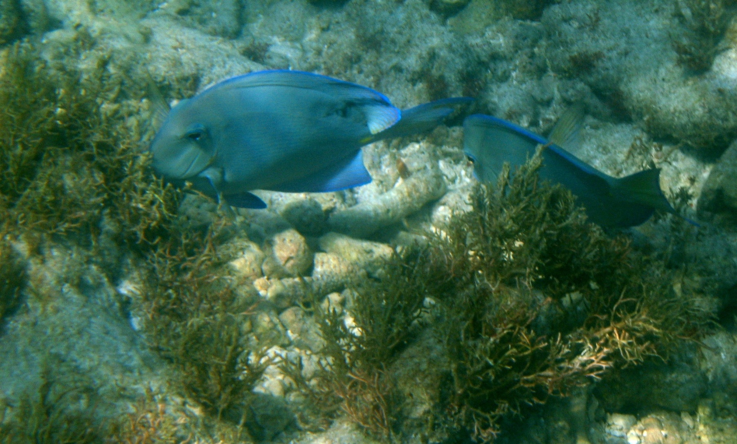
Blue parrotfish

Slide 18
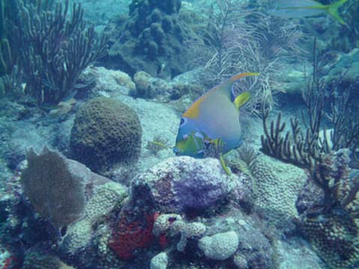
Queen angelfish

Slide 19
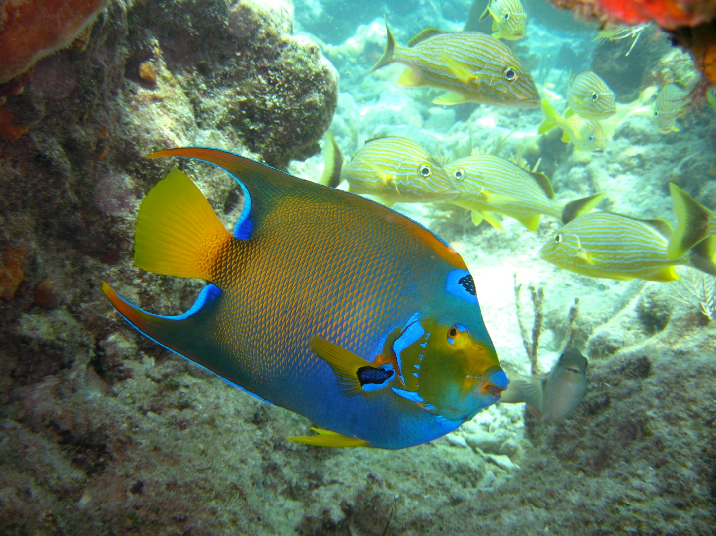
Queen angelfish

Slide 20
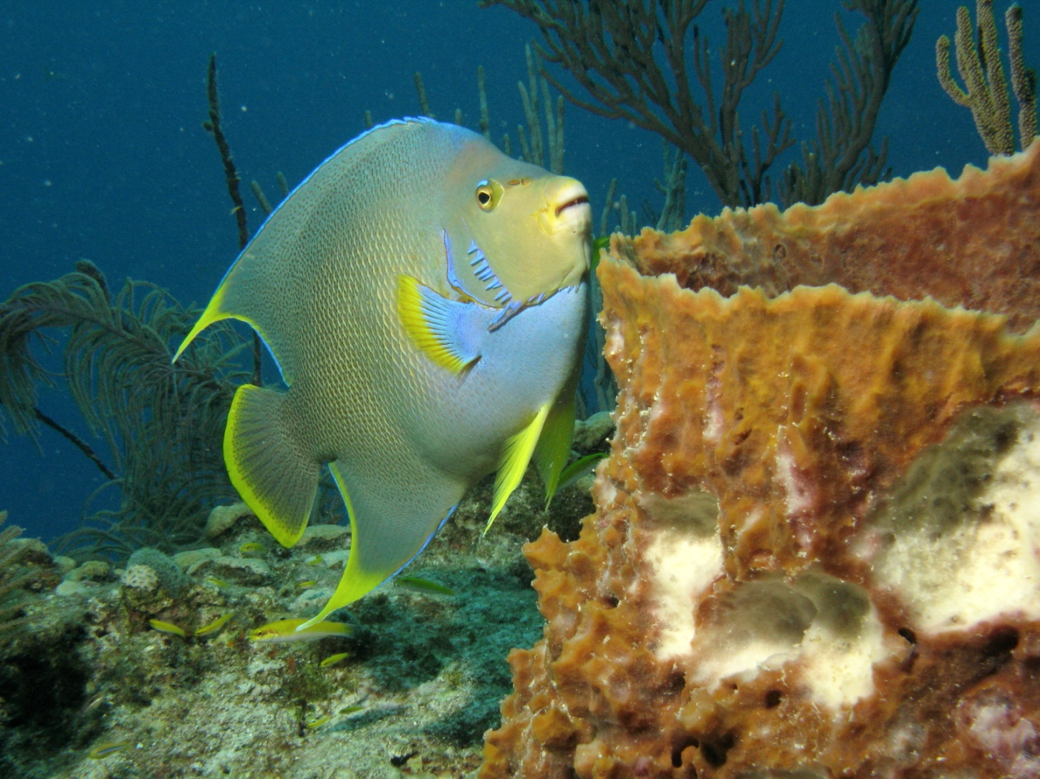
Blue angelfish

Slide 21
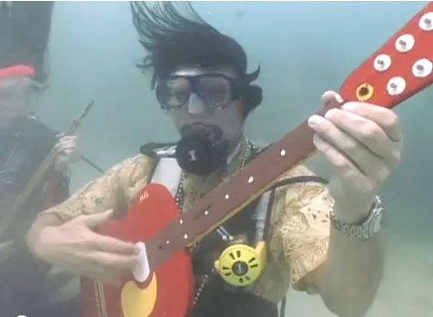
Underwater music festival

Slide 22
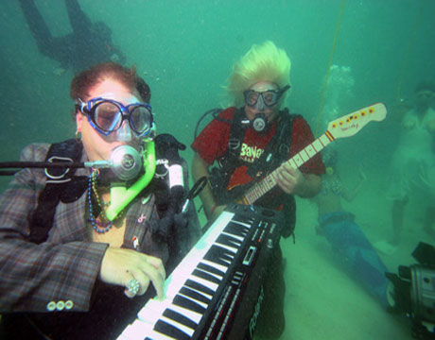
Underwater music festival

